Slide 1
The Transition Metals, the Lanthanides and the Antinides

Slide 2
Transition Elements
3
The Metals in the Middle
Groups 3-12 are called the transition elements.
All of them are metals.
Across any period from Group 3 through 12, the properties of the elements change less noticeably than they do across a period of representative elements.
Most transition elements are found combined with other elements in ores.

Slide 3
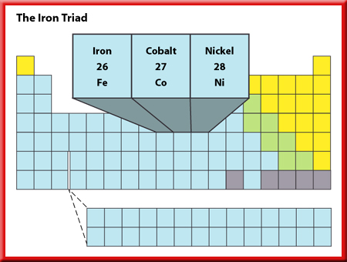
Transition Elements
3
The Iron Triad
Three elements in period 4—iron, cobalt, and nickel—have such similar properties that they
are known as the iron triad.
These elements, among others, have magnetic properties.

Slide 4
Transition Elements
3
The Iron Triad
Industrial magnets are made from an alloy of nickel, cobalt, and aluminum.
Nickel is used in batteries along with cadmium.
Iron is a necessary part of hemoglobin, the substance that transports oxygen in the blood.
Iron also is mixed with other metals and with carbon to create a variety of steels with different properties.

Slide 5
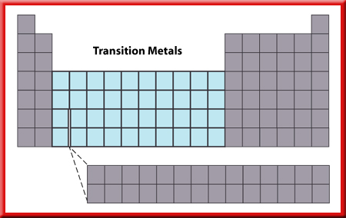
Transition Elements
3
Uses of Transition Elements
Most transition metals have higher melting points than the representative elements.
The filaments of lightbulbs are made of
tungsten, element 74.

Slide 6
Transition Elements
3
Uses of Transition Elements
Tungsten has the highest melting point of any metal (3,410°C) and will not melt when a current passes through it.

Slide 7
Transition Elements
3
Uses of Transition Elements
Mercury, which has the lowest melting point of any metal (–39°C), is used in thermometers and in barometers.
Mercury is the only metal that is a liquid at room temperatures.
Like many of the heavy metals, mercury is poisonous to living beings.

Slide 8
Transition Elements
3
Uses of Transition Elements
Chromium’s name comes from the Greek word for color, chrome.
Many other transition elements combine to form substances with brilliant colors.

Slide 9
Transition Elements
3
Uses of Transition Elements
Ruthenium, rhodium, palladium, osmium, iridium, and platinum are sometimes called the platinum group because they have similar properties.
They do not combine as easily with other elements.
As a result, they can be used as catalysts.

Slide 10
Transition Elements
3
Uses of Transition Elements
A catalyst is a substance that can make something happen faster but is not changed itself.
Other transition elements, such as nickel, zinc, and cobalt, can be used as catalysts.

Slide 11
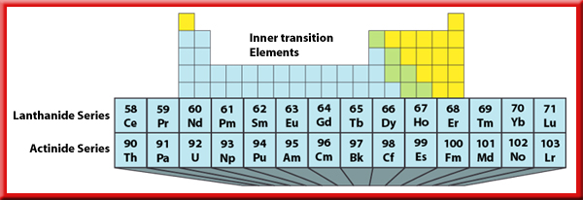
Transition Elements
3
Inner Transition Elements
There are two series of inner transition elements.
The first series, from cerium to lutetium, is called the lanthanides.
The second series of elements, from thorium to lawrencium, is called the actinides.

Slide 12
Transition Elements
3
The Lanthanides
The lanthanides are soft metals that can be cut with a knife.
The elements are so similar that they are hard to separate when they occur in the same ore, which they often do.
Despite the name rare earth, the lanthanides are not as rare as originally thought.
Cerium makes up 50 percent of an alloy called misch (MIHSH) metal.
Flints in lighters are made from misch metal.

Slide 13
Transition Elements
3
The Actinides
All the actinides are radioactive.
The nuclei of atoms of radioactive elements are unstable and decay to form other elements.
Thorium, protactinium, and uranium are the only actinides that now are found naturally on Earth.
Uranium is found in Earth’s crust because its half-life is long—4.5 billion years.

Slide 14
Transition Elements
3
The Actinides
All other actinides are synthetic elements.
Synthetic elements are made in laboratories and nuclear reactors.
Plutonium is used as a fuel in nuclear power plants.
Americium is used in some home smoke detectors.
Californium-252 is used to kill cancer cells.

Slide 15
Transition Elements
3
Dentistry and Dental Materials
Dentists have been using amalgam for over 150 years to fill cavities in decayed teeth.
Amalgam, a mixture of silver, copper, tin, and mercury, is the familiar “silver filling.”

Slide 16
Transition Elements
3
Dentistry and Dental Materials
Because amalgam contains mercury, some people are concerned that the use of this particular type of filling may unnecessarily expose a person to mercury vapor.

Slide 17
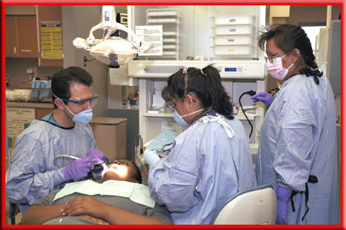
Transition Elements
3
Dentistry and Dental Materials
Today dentists have alternatives to amalgam. New composites, resins, and porcelains are
being used to repair decayed, broken, or missing teeth.

Slide 18
Section Check
3
Question 1
Which three elements are known as “the iron triad”?
Answer
The iron triad consists of iron, cobalt, and nickel. They are called this because of their similar properties.

Slide 19
Section Check
3
Question 2
Which group consists of ruthenium, rhodium, palladium, osmium, iridium, and platinum?
Answer
The answer is the platinum group. These elements all have similar properties, which is why they are grouped together.

Slide 20
Section Check
3
Question 3
What is most notable about the nuclei of the actinides?
Answer
The nuclei of actinides are unstable. All the actinides are radioactive, which means they decay to form other elements.

Slide 21
This powerpoint was kindly donated to www.worldofteaching.com
http://www.worldofteaching.com is home to over a thousand powerpoints submitted by teachers. This is a completely free site and requires no registration. Please visit and I hope it will help in your teaching.

